Slide 1
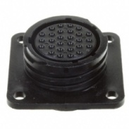
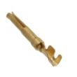

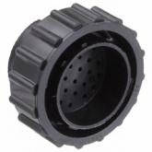
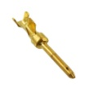
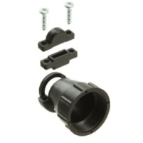
TOOLHEAD to DUET PIN MAPPING
Toolhead-side connector parts:
14X
PER
EXTRUDER
Female PIN
(DigiKey: A1009-ND )
1X
PER 2
EXTRUDERS
Female connector (DigiKey: A1378-ND)
Mono-Extruder Connectivity
EXTRUDER 0
A B
Cable-side connector parts:
14X
PER
EXTRUDER
Male pin
(DigiKey: A1679CT-ND )
1X
PER 2
EXTRUDERS
Male connector housing (DigiKey: A1380-ND)
Multi-Extruder Connectivity
EXTRUDER 0
EXTRUDER 2
1X
PER 2
EXTRUDERS
Male connector backshell
(DigiKey: A32516-ND)
A B
EXTRUDER 1
EXTRUDER 3
---------------------- (ALL PART NUMBERS ALSO LISTED IN BOM) ---------------------
TOOLHEAD PIN | DESTINATION PIN (Connector A / Connector B) | FUNCTION (Connector A / Connector B) | WIRE USED ON CABLE HARNESS (each color indicates a separate cable) | EXTRUDER 0 OR 2
1 | 5V (5V Supply) | Smoke Sensor 0/2: VCC (+5VDC) | 24AWG 4-conductor shielded twisted pair (Belden 9502), Red
2 | 0V (5V Supply) | Smoke Sensor 0/2: GND (0VDC) | 24AWG 4-conductor shielded twisted pair (Belden 9502), Black
3 | Any unused input (Arduino) | Smoke Sensor 0/2: Output | 24AWG 4-conductor shielded twisted pair (Belden 9502), White
4 | Drive 2: 2B (Duet) / Drive 8: 2B (Duex) | Motor 0/2: lead 2B (Red) | 24AWG 4-conductor shielded twisted pair (Belden 9502), Red
5 | Drive 2: 2A (Duet) / Drive 8: 2A (Duex) | Motor 0/2: lead 2A (Blue) | 24AWG 4-conductor shielded twisted pair (Belden 9502), Black
6 | FAN1 V_FAN (Duet) / FAN6: V_FAN (Duex) | Extruder Fan 0/2: VCC | 24AWG 4-conductor shielded twisted pair (Belden 9502), Red
 |  | Cooling Fan 0/2: VCC
7 | FAN1: FAN1- (Duet) / FAN6: FAN6- (Duex) | Extruder Fan 0/2: GND | 24AWG 4-conductor shielded twisted pair (Belden 9502), Black
8 | FAN0 : V_FAN (Duet) / FAN5: V_FAN (Duex) | Cooling Fan 0/2 :GND | 24AWG 4-conductor shielded twisted pair (Belden 9502), Black
9 | Drive 2 : 1B (Duet) / Drive 8: 1B (Duex) | Motor 0/2: lead 1B (Black) | 24AWG 4-conductor shielded twisted pair (Belden 9502), Black
10 | Drive 2 : 1A (Duet) / Drive 8: 1A (Duex) | Motor 0/2: lead 1A (Green) | 24AWG 4-conductor shielded twisted pair (Belden 9502), White
11 | E0 Thermistor: VSSA (Duet) / E2 Thermistor: VSSA (Duex) | Extruder Thermistor 0/2: Output | 24AWG 4-conductor shielded twisted pair (Belden 9502), Black or White
12 | E0 Thermistor: THERMISTOR1 (Duet) / E2 Thermistor: THERMISTOR3 (Duex) | Extruder Thermistor 0/2: Output | 24AWG 4-conductor shielded twisted pair (Belden 9502), Black or White
13 | E0 Heater: E0- (Duet) / E2 Heater: E2- (Duex) | Extruder Heater 0/2: Input | 20AWG twisted pair, order unimportant
14 | E0 Heater: VIN (Duet) / E2 Heater: VIN (Duex) | Extruder Heater 0/2: Input | 20AWG twisted pair, order unimportant
15 | E1 Heater: VIN (Duet) / E3 Heater: VIN (Duex) | Extruder Heater 1/3: Input | 20AWG twisted pair, order unimportant | EXTRUDER 1 OR 3
16 | E1 Heater: E1- (Duet) / E3 Heater: E3- (Duex) | Extruder Heater 1/3: Input | 20AWG twisted pair, order unimportant
17 | E1 Thermistor: THERMISTOR2 (Duet) / E3 Thermistor: THERMISTOR4 (Duex) | Extruder Thermistor 1/3: Output | 24AWG 4-conductor shielded twisted pair (Belden 9502), Black or White
18 | E1 Thermistor: VSSA (Duet) / E3 Thermistor: VSSA (Duex) | Extruder Thermistor 1/3: Output | 24AWG 4-conductor shielded twisted pair (Belden 9502), Black or White
19 | Drive 7: 1A (Duex) / Drive 9: 1A (Duex) | Motor 1/3: lead 1A (Green) | 24AWG 4-conductor shielded twisted pair (Belden 9502), White
20 | Drive 7: 1B (Duex) / Drive 9: 1B (Duex) | Motor 1/3: lead 1B (Black) | 24AWG 4-conductor shielded twisted pair (Belden 9502), Black
21 | FAN3: V_FAN (Duex) / FAN7: V_FAN (Duex) | Cooling Fan 1/3: GND | 24AWG 4-conductor shielded twisted pair (Belden 9502), Black
22 | FAN4: FAN4- (Duex) / FAN8: FAN8- (Duex) | Extruder Fan 1/3: GND | 24AWG 4-conductor shielded twisted pair (Belden 9502), Black
23 | FAN4: V_FAN (Duex) / FAN8: V_FAN (Duex) | Extruder Fan 1/3: VCC | 24AWG 4-conductor shielded twisted pair (Belden 9502), Red
 |  | Cooling Fan 1/3 :VCC
24 | Drive 7: 2A (Duex) / Drive 9: 2A (Duex) | Motor 1/3: lead 2A (Blue) | 24AWG 4-conductor shielded twisted pair (Belden 9502), Black
25 | Drive 7: 2B (Duex) / Drive 9: 2B (Duex) | Motor 1/3: lead 2B (Red) | 24AWG 4-conductor shielded twisted pair (Belden 9502), Red
26 | Any unused input (Arduino) | Smoke sensor 1/3: output | 24AWG 4-conductor shielded twisted pair (Belden 9502), White
27 | 0V (5V Supply) | Smoke Sensor 1/3 :GND (0VDC) | 24AWG 4-conductor shielded twisted pair (Belden 9502), Black
28 | 5V (5V Supply) | Smoke Sensor 1/3: VCC (+5VDC) | 24AWG 4-conductor shielded twisted pair (Belden 9502), Red

Slide 2
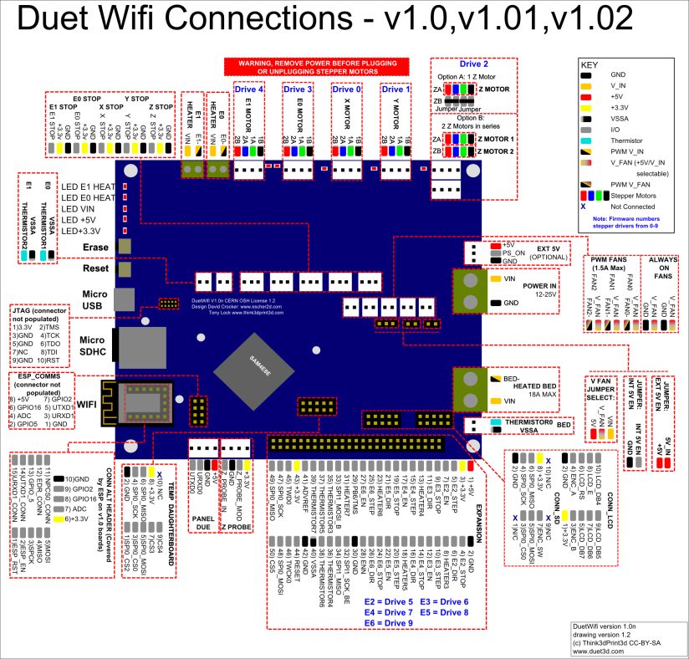
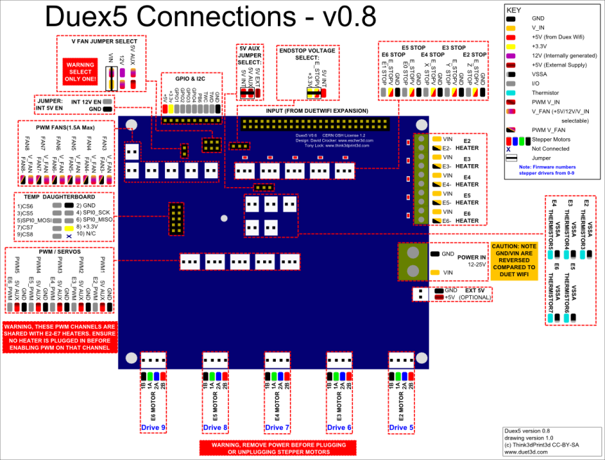
DUET and DUEX5 WIRING

Slide 3
CHASSIS WIRING (POWER, BED HEATERS)

